Slide 1

Business Operations
Module - 6

Slide 2

Welcome!!

Slide 3
Module Logic
Finance 101
Outlines
The Basics
Accounting Assumptions
The need for a lantern
Financial Statements Introduction
Financial Statements Interpretation and Analysis
Credit Ratings and how to land on a positive credit rating
Fixed and Variable Costs
Price Determination

Slide 4
Cash flow management
Cash flow budget creation and Forecasting
Outlines
Breakeven Analysis
Practical Activities
References

Slide 5

Module Logic
Module Objective
Entrepreneurial Finance
Crucial component to success
Overlooking the pillar
Reasons of Success and Failure

Slide 6
Finance 101
Real Life Case
Three Main types of Finance
Finance and Entrepreneurial Finance

Slide 7

Assets
  Definition
  Listings
Liabilities
  Definition
  Listings
Owner’s Equity
  Definition
  Listings
Accounting Equation
The Basics

Slide 8
Accounting Assumptions

Slide 9
Accrual assumption
Conservatism assumption
Consistency assumption
Economic entity assumption
Going concern assumption
Reliability assumption
Time period assumption

Slide 10

The need for a lantern

Slide 11
Start a business
Finance expansions to production capacity
To develop and market new products
To enter new markets
Take-over or acquisition
Moving to new premises
To pay for the day to day running of business
Choosing the Right Source of Finance
Amount of money required
How quickly the money is needed
The cheapest option available
The amount of risk involved in the reason for the cash
The length of time of the requirement for finance

Slide 12
Financial Statements Introduction
Income statement
Statement of retained earnings
Balance sheet
Cash flow statement

Slide 13
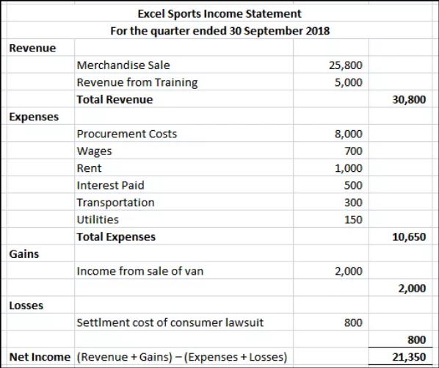
Income Statement
Revenues
Gains
Expenses
Losses

Slide 14
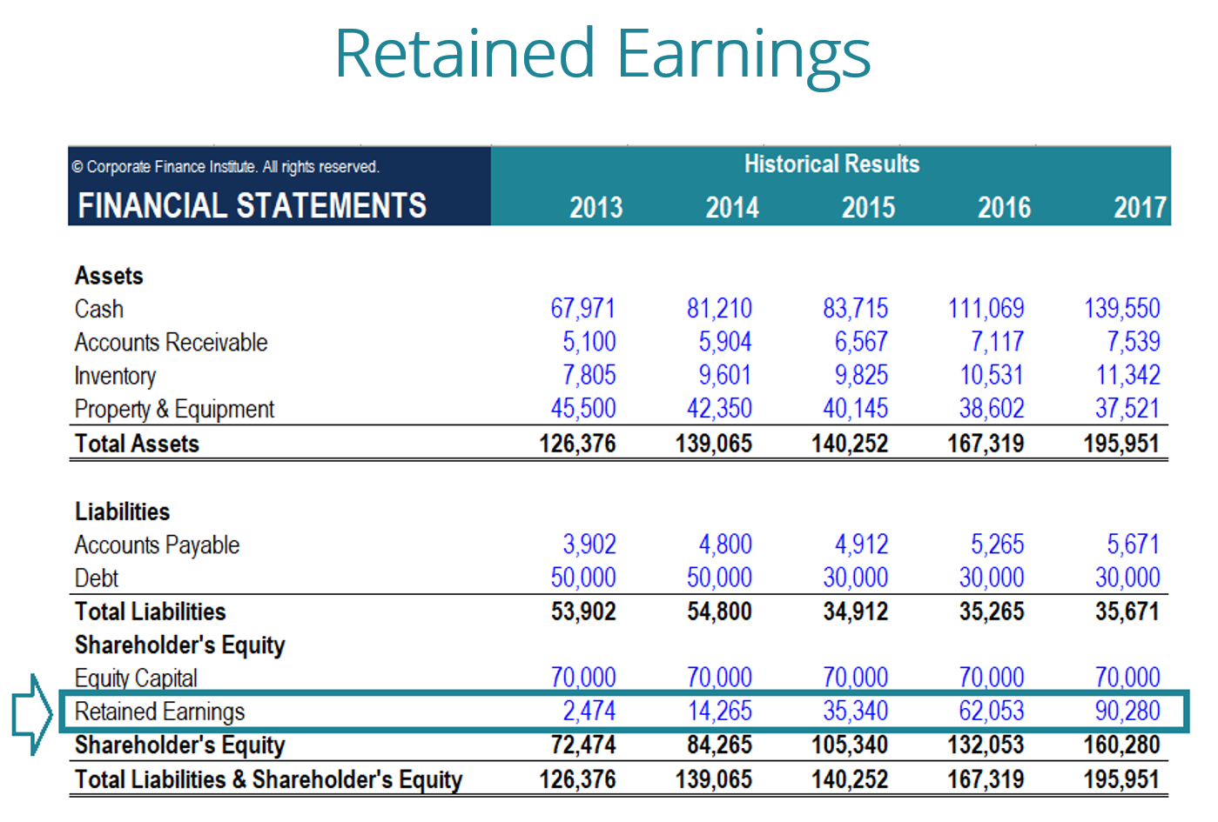
Statement of Retained Earnings

Slide 15
What is “Retained Earnings”?
Recording Changes
Separate Document or an inclusion

Slide 16
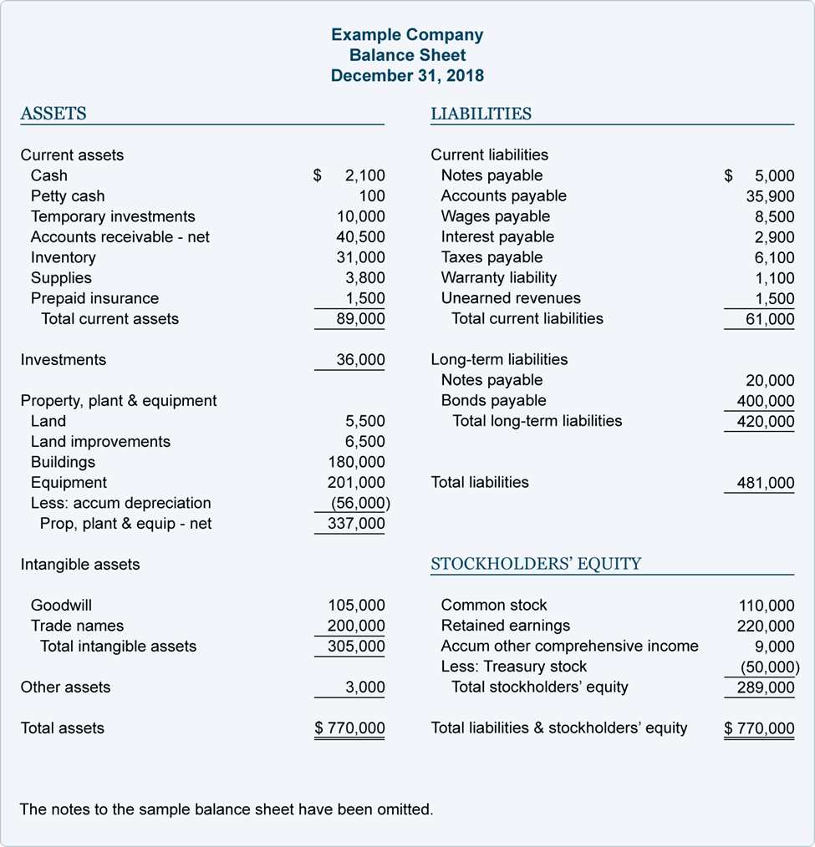
Balance Sheet
Revisiting Assets, Liabilities
and Owner’s Equity

Slide 17
Cash Flow Statement

Slide 18
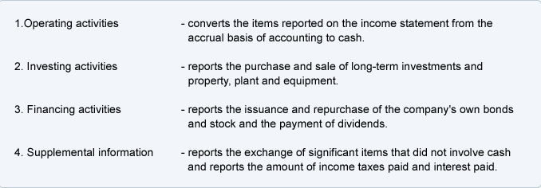
The cash flow statement organizes and reports the cash generated and used in the following categories:

Slide 19
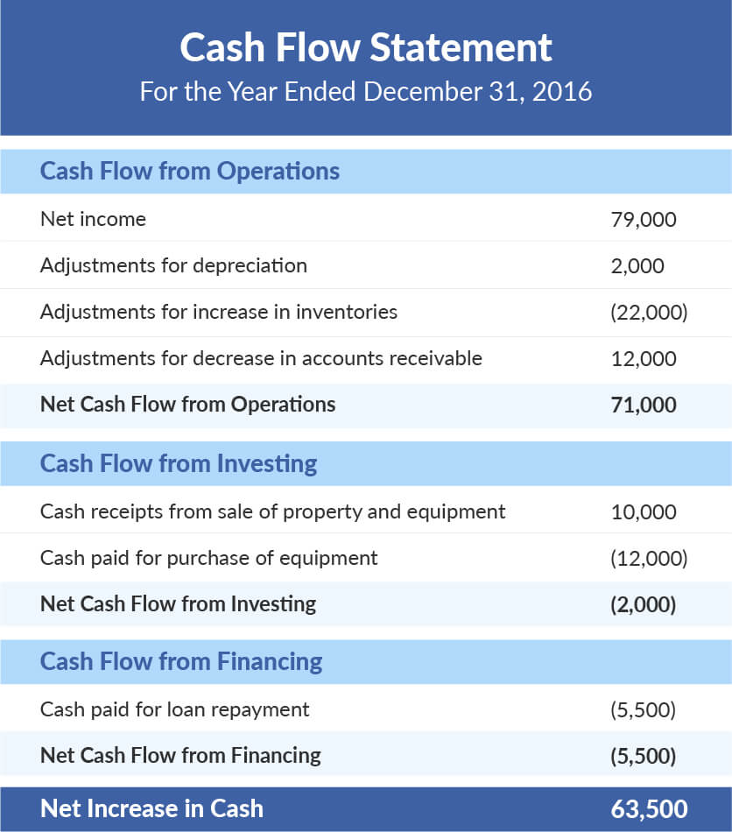
Cash Flow
Statement

Slide 20
Financial Statements
Interpretation and Analysis
Action Plan
  Identify the industry economic characteristics. ...
  Identify company strategies. ...
  Assess the quality of the firm's financial statements. ...
  Analyze current profitability and risk. ...
  Prepare forecasted financial statements. ...
  Value the firm.
The Financial Ratios

Slide 21
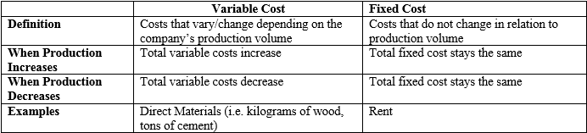
Fixed and Variable Costs

Slide 22
Price Determination
De Facto Rules
    All prices must cover costs and profits.
    The most effective way to lower prices is to lower costs.
    Review prices frequently to assure that they reflect the dynamics of cost, market demand, response to the competition, and profit objectives.
    Prices must be established to assure sales.
When to Review Prices
Pricing Strategies

Slide 23
Cash flow management
Cash Flow Management Definition
Action Plan to go Green
  1. Managing your payables
  2. Improving your receivables
  3. Preparing cash flow projections
  4. Avoid over-investing
  5. Taking out short-term loans

Slide 24
Cash flow budget creation
and Forecasting

Slide 25
Project your collections
Add in the amount you expect to collect from your accounts receivable, taking into account any variances in your “net” terms versus actual collection cycles from your clients or customers
What other cash are you expecting to bring into your business?
Detail your expenses and other cash outlays
Take a look at your accounts payable from the previous period

Slide 26
Breakeven Analysis
The Definition
Considering Fixed and Variables Costs
Semi Variable Costs
A Practical Approach

Slide 27

Practical Activities

